Slide 1
SOUTH AFRICAN WEATHER SERVICE
South African Weather Service:
Solution for Everyone, Everyday
18 - 19 March 2019
Deon Terblanche
Special Science Advisor / Acting Executive Infrastructure and Information Systems

Slide 2


Slide 3
Content
Current Realities and looking Forward
International Research Programme Response
The SAWS Response

Slide 4
Current Realities and Looking Forward

Slide 5
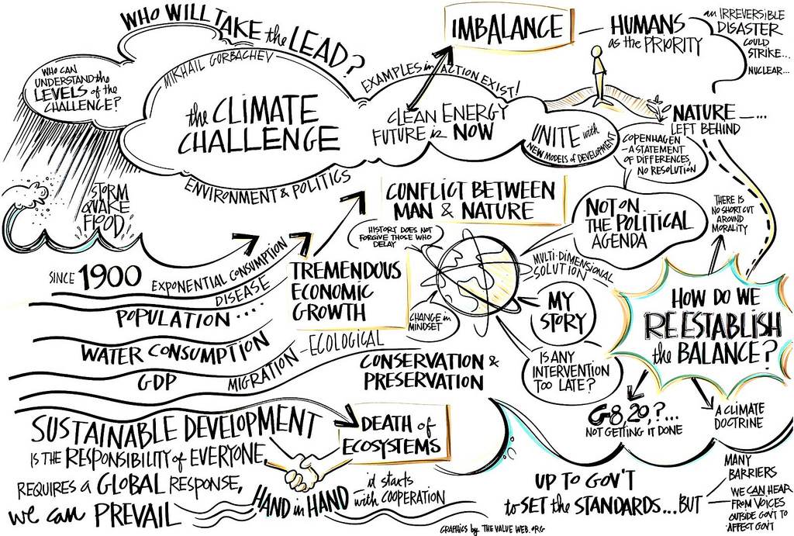
A Complex World

Slide 6
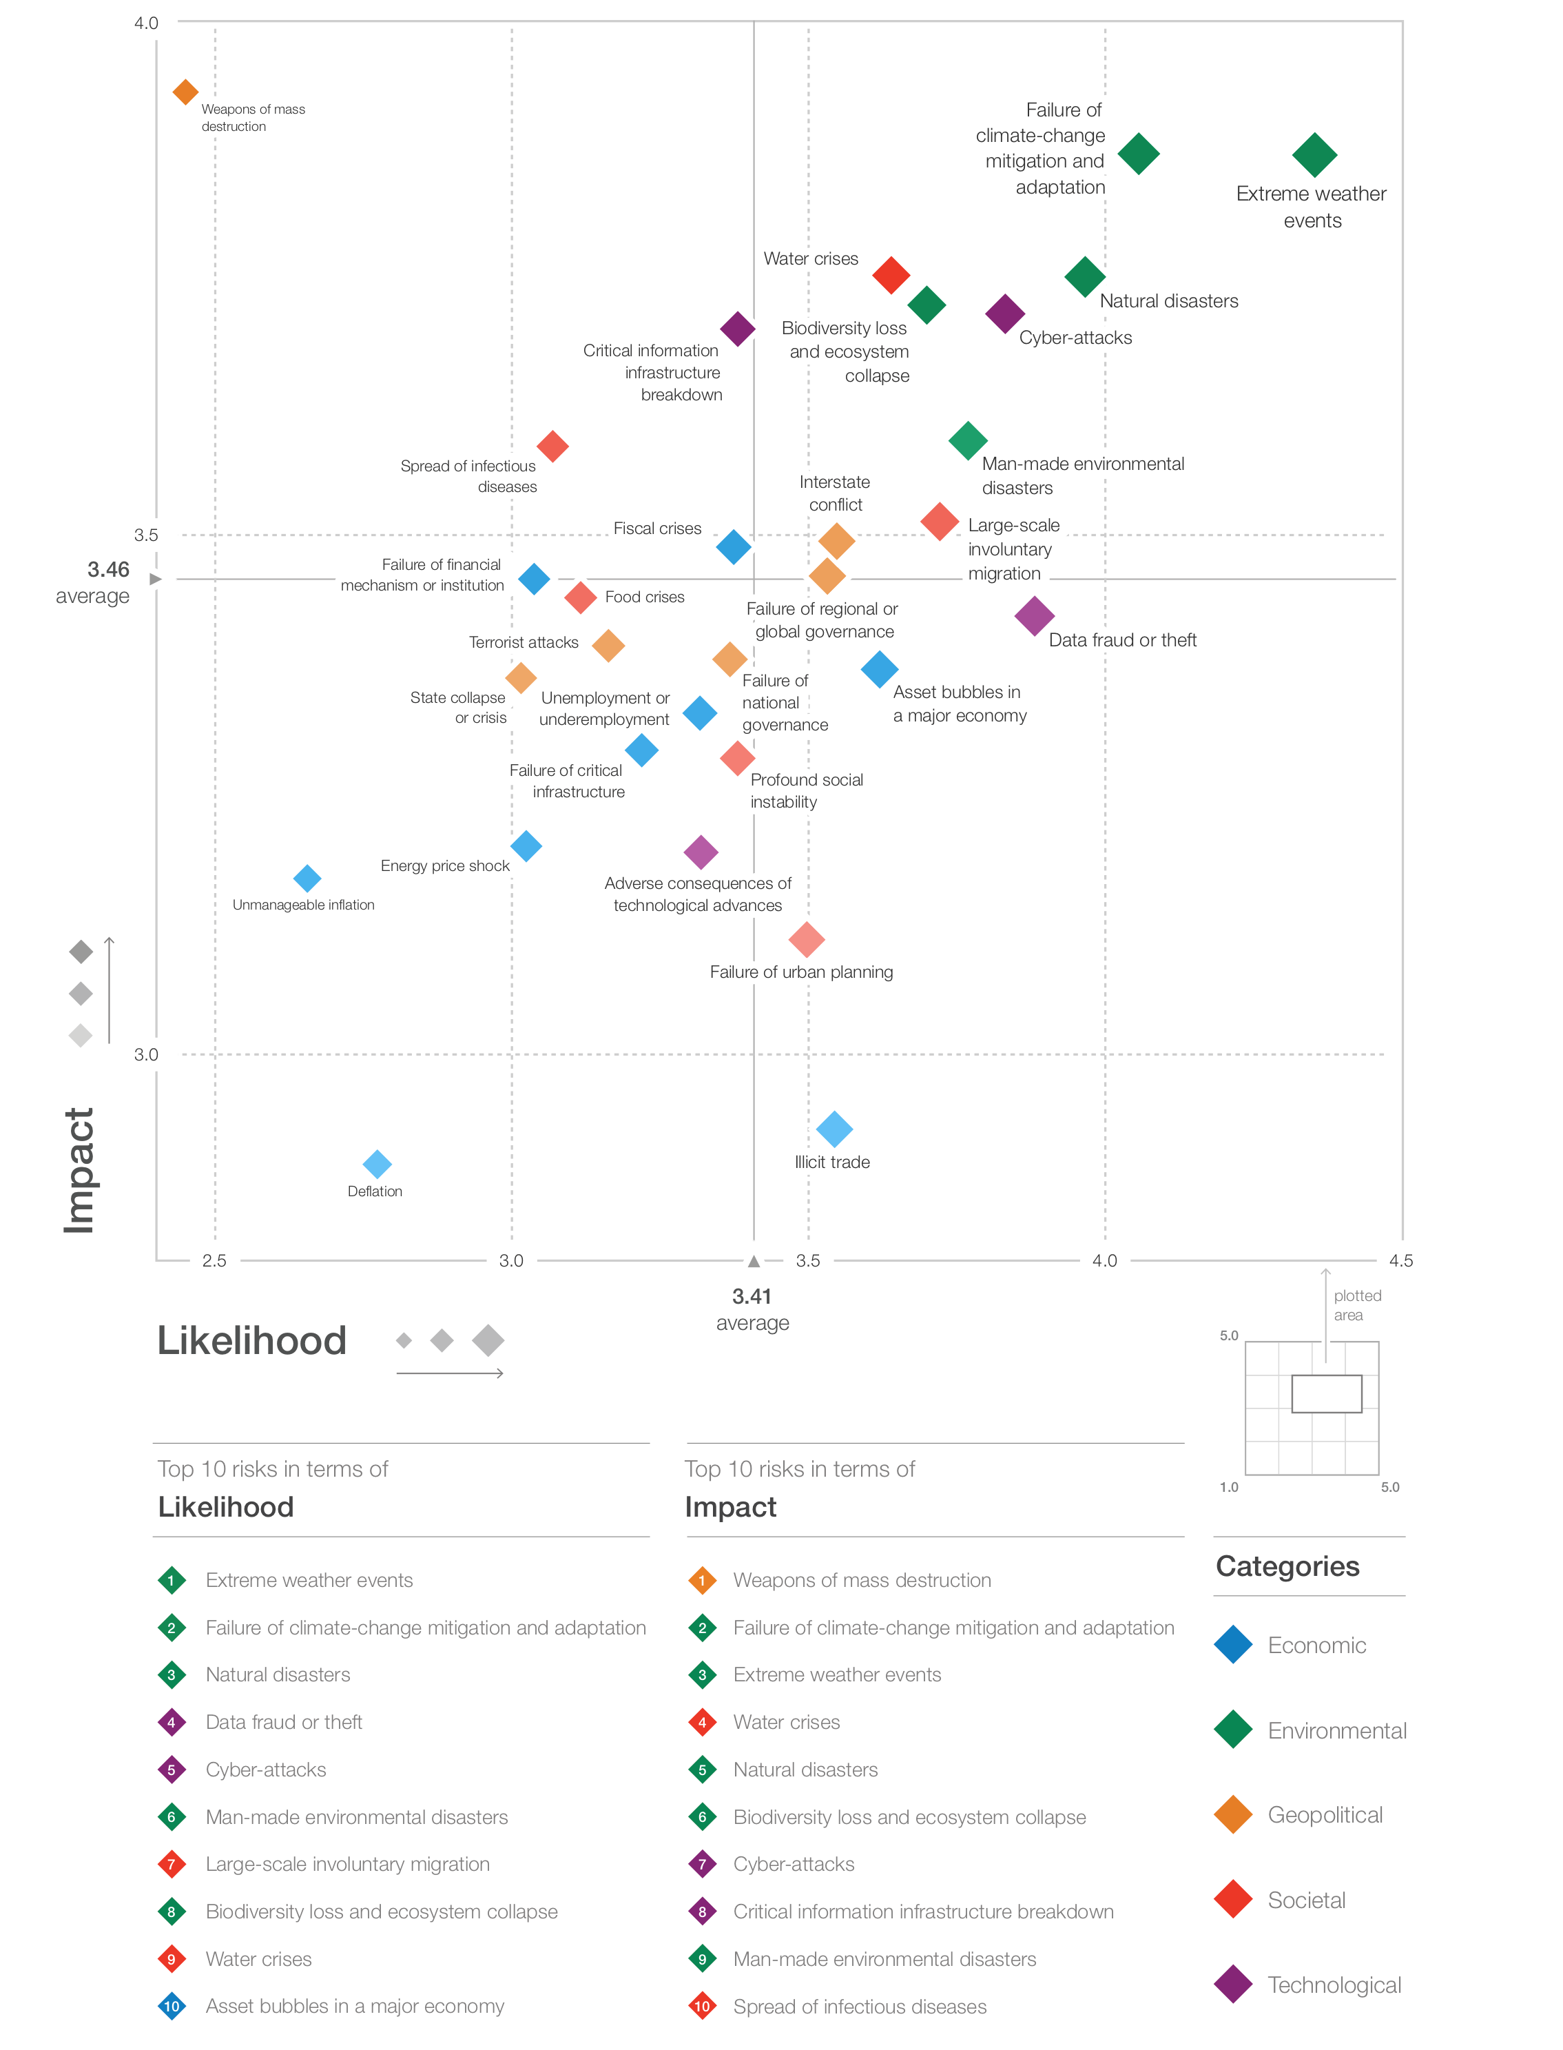
World Economic Forum Global Risk Report 2019

Slide 7
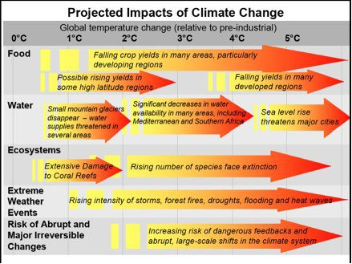
Climate Change and our Daily Weather

Slide 8
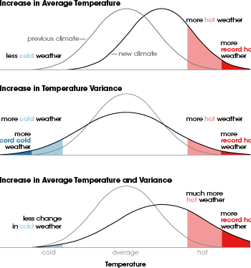
Climate Change and our Daily Weather

Slide 9
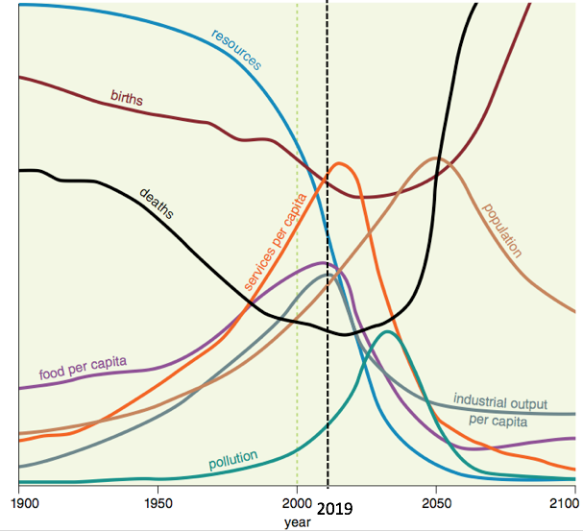

Limits to Growth?
The Limits to Growth (LTG) is a 1972 report on the computer simulation of exponential economic and population growth with a finite supply of resources.

Slide 10



2015: A landmark Year
Over 190 countries signed up to reduce emissions, with the target to stay within a 2ºC world.
15-year agreement for the substantial reduction of disaster risk and losses in lives, livelihoods and health.
2030 agenda with 17 goals to end poverty and hunger, improve health and education, making cities more sustainable, combating climate change, and protecting oceans and forests.
Understanding and Quantifying Weather and Climate Risk are at the Core of these Actions

Slide 11
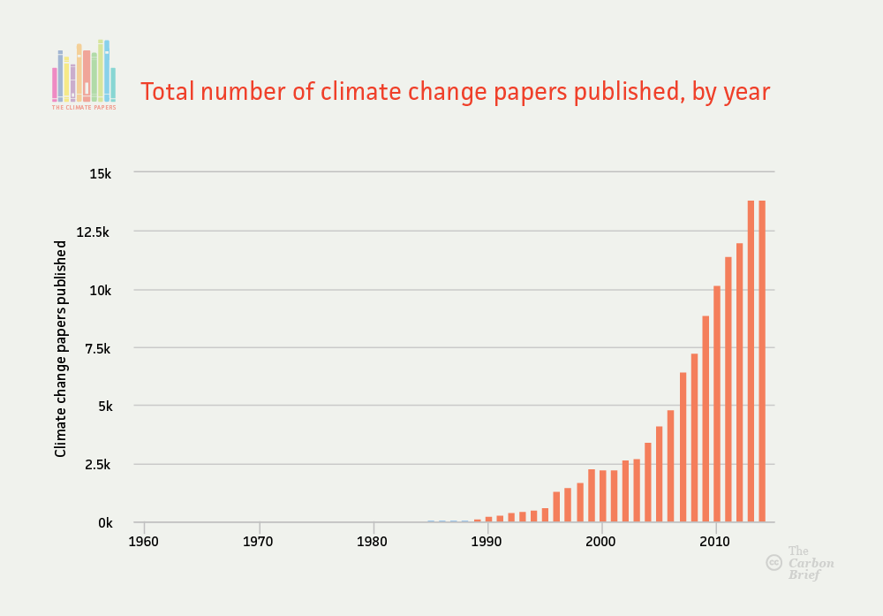
Growth in Knowledge

Slide 12
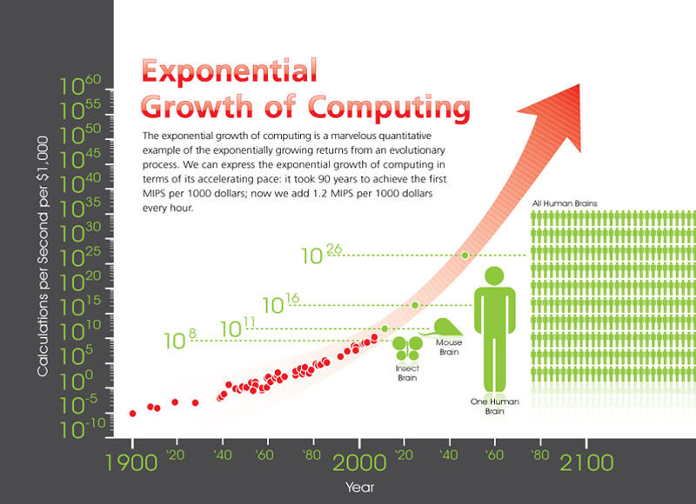
Growth in Technology

Slide 13
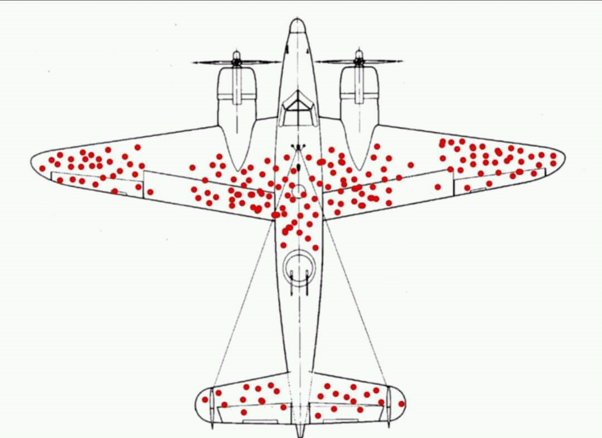
Correct Situational Interpretation
Were to improve armour to WWII bombers?
Analysing damage on returning aircraft suggested the areas with damage
Abraham Wald suggested the nose, engines and rear central fuselage

Slide 15
International Research Programme Response

Slide 16
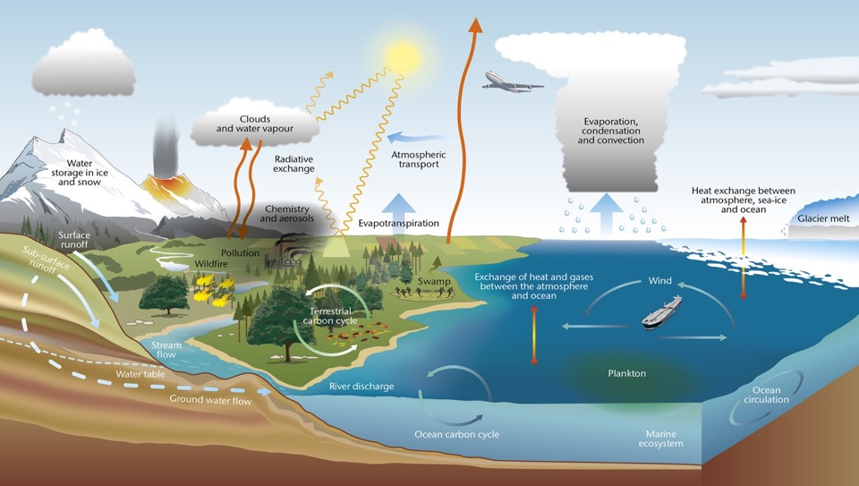
Taking a holistic view of the Earth System

Slide 17
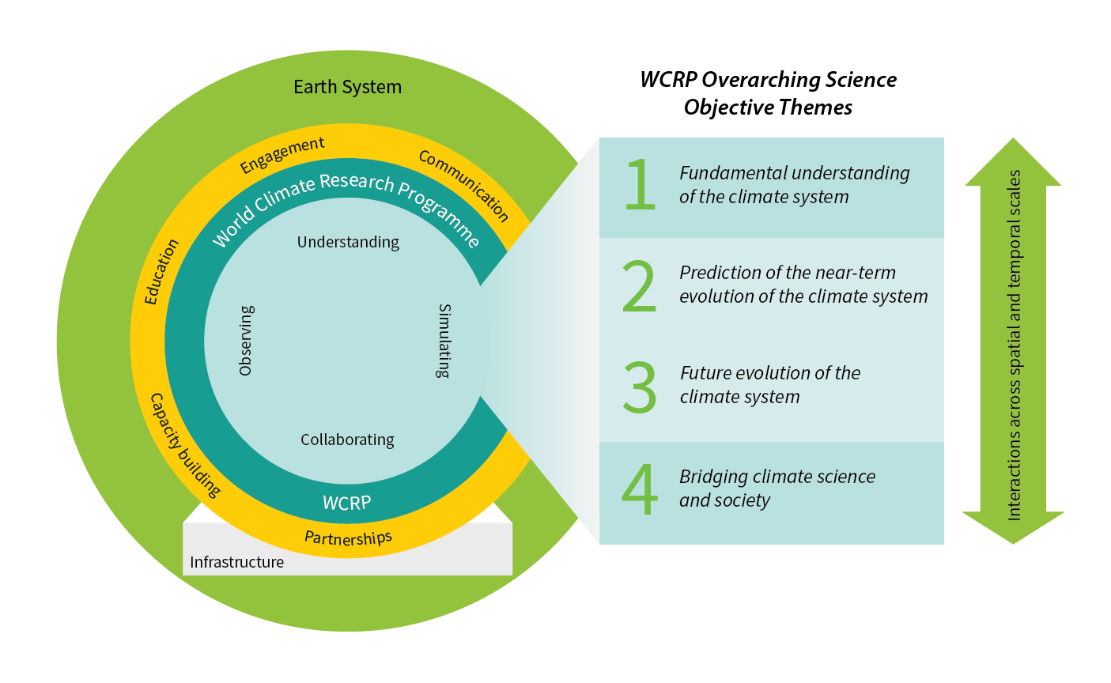
WCRP Strategic Plan

Slide 18

Objective 1
WCRP Strategic Plan
Advancement of sciences that enable an integrated and fundamental understanding of the climate, its variations and its changes, as part of a coupled physical, biogeochemical, and socio-economic system.
Emphases:
Climate dynamics: past and future global and regional changes in oceanic and atmospheric circulations
Reservoirs and flows: radiative, hydrologic, cryospheric and biogeochemical changes on energy, water, carbon, and other climate-relevant compounds

Slide 19

Objective 2
WCRP Strategic Plan
Frontiers of predictions and quantify the associated uncertainties for sub- seasonal to decadal time scales across all climate system components.
Emphases:
Simulation capabilities of component systems and their coupling. Deterministic, statistical and machine learning approaches. Data assimilation and ensemble generation
Predicting extreme events: regional climate hotspots and potential for crossing thresholds. Interactions between fact and slow extremes

Slide 20

Objective 3
WCRP Strategic Plan
Quantify the responses, feedbacks and uncertainties intrinsic to the changing climate system on longer timescales.
Emphasis:
Earth system models. Development and integration. Representation of complex interactions between aquifers, vegetation and soil carbon, between permafrost, glaciers, and ice-sheets. Dynamical and statistical downscaling

Slide 21
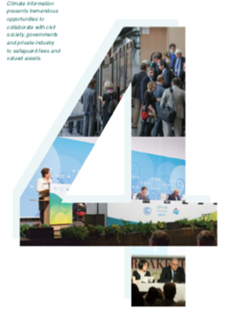
Objective 4
WCRP Strategic Plan
Innovation in the generation of decision-relevant information and knowledge about the evolving Earth system.
Emphasis:
Interactions with social systems: Social processes and emergent behaviour in the Earth System. Interactions and feedbacks between climatic and socioeconomic systems
Engaging with society: Actionable climate information, scientific assessments, educational approaches and public communication strategies.

Slide 22

Critical Infrastructures
WCRP Strategic Plan
I. A hierarchy of simulation tools
II. Observations for process understanding
III. Sustained observations
IV. High-end computing and data management

Slide 23
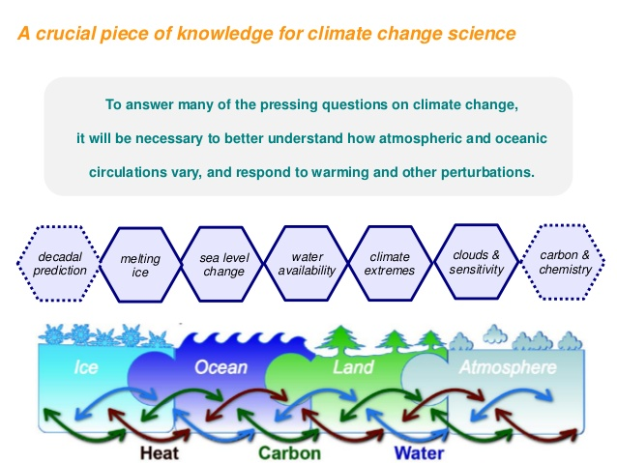

Slide 24
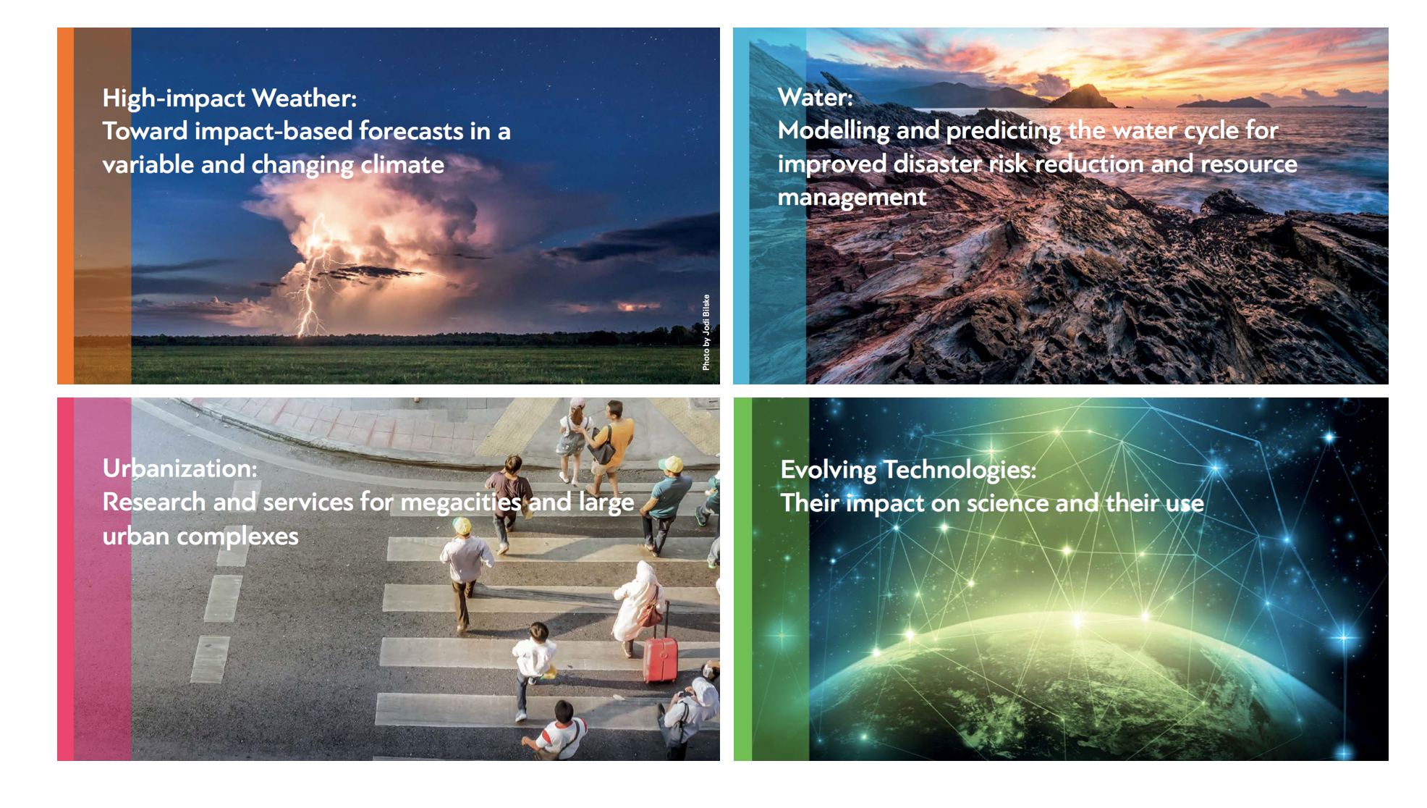
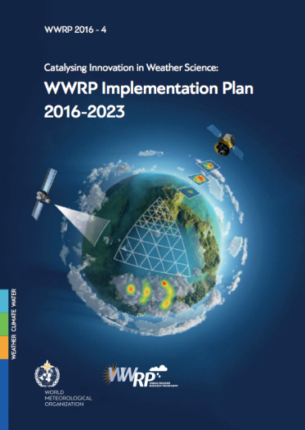

WWRP activities focus on four challenges
A guide to catalyze innovation
Notes:
Mention LCP here
Use maybe the IP pictures for challenges
PC in salle B could be very slow
Outcome of the World Weather Open Science Conference 2014 (WWOSC) in Montreal
Developed by the WWRP SSC, WGs and Projects, based on outcomes of the WWOSC

Slide 25













Three Core Projects
High Impact Weather
Prediction Project
Sub-seasonal to Seasonal
Prediction Project
Polar
Prediction Project
Int Coordination Office - China
Int Coordination Office – South Korea
Int Coordination Office – Germany
Multi-scale forecasts, warnings and impacts
Predictability & Uncertainty
Vulnerability & Risk
User communication
Timescale:
Minutes to two weeks
Urban jointly with GAW
Improve forecast skill
Tropical cyclones, droughts, floods, heat waves, monsoons,…
Data exchange and accessibility
S2S Database
Timescale:
Two weeks to seasons
Jointly with WCRP
Develop improved weather and environmental prediction services
Year of Polar Prediction:
(mid 2017-mid 2019)
Timescale:
From hours to seasons
In coordination with WCRP, OBS involvement
Notes:
Use Donors brochure pictures ....
Bigger names of projects …

Slide 26



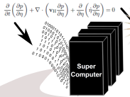
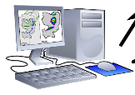
…following a value chain approach…
Warning and preparedness
Seamless Earth System Modelling
Impact Forecast
Observations
Decision
Extreme
Hazard
Exposure
Vulnerability
Impact
Sensor Technology
Atmosphere, Ocean, Land Surface & Pollution Modelling
Reduce Impact
Social, Economic & Health Modelling
Communication Science: Messages & Media
Behavioural Psychology

Slide 27

Climate Services

Slide 28
The SAWS Response

Slide 29
SAWS Strategy 2019/2020 – 2023/2024
Strategic Programmes and Objectives
Programme 1: Weather and Climate Services
  The purpose of this programme is to develop and provide meteorological solutions to all South Africans every day.
  The programme is anchored on 3 strategic objectives with 9 targets.
  The strategic objectives encompass:
    Warnings, alerts and advisories: Public, Impact based forecasting, DRR
    Climate Services: NFCS
    Sector-specific solution service delivery / dissemination: Air Quality, Aviation, Marine etc.
Programme 2: Research and Innovation
  The programme focusses on the generation of new scientific insights in atmospheric and related sciences, specifically as related to weather, climate and related environmental matters and developing user relevant and innovative products and services to support socio-economic development and build resilience.
  The programme is anchored on 2 strategic objectives with 4 targets.
  The strategic objectives encompass:
    Research
    Solution development / maintenance

Slide 30
SAWS Strategy 2019/2020 – 2023/2024
Strategic Programmes and Objectives
Programme 3: Infrastructure and Information Systems
  The purpose of programme is to upgrade, expand and optimise the SAWS observational infrastructure, as well as the communication, processing and data systems that form the bedrock of the SAWS value chain. These include the all the observation systems over South Africa and the surrounding oceans, the ICT systems required to run numerical models to ensure that South Africans can benefit from weather and climate services and the communication system to ensure that these services reach the population.
  The programme is anchored on 2 strategic objectives and 11 targets.
  The strategic objectives encompass:
    Optimal management of infrastructure
    Quality data

Slide 31
SAWS Strategy 2019/2020 – 2023/2024
Strategic Programmes and Objectives
Programme 4: Administration and Corporate Services
  The functions of the programme consists of the Human Capital Management, Compliance, Total Quality Management, Occupational Health and Safety, Branding and Communication.
  The purpose is to provide leadership, strategic, centralised administration, executive support, corporate services and, facilitate effective cooperative governance, international relations and environmental education and awareness.
  The programme is anchored on 5 strategic objectives 17 targets.
  The strategic objectives encompass:
    Sound corporate governance
    Adequate, appropriately skilled, transformed and diverse workforce
    Stakeholder engagement network development
    Corporate communication / branding
    Secure, harmonious and conducive working environment

Slide 32
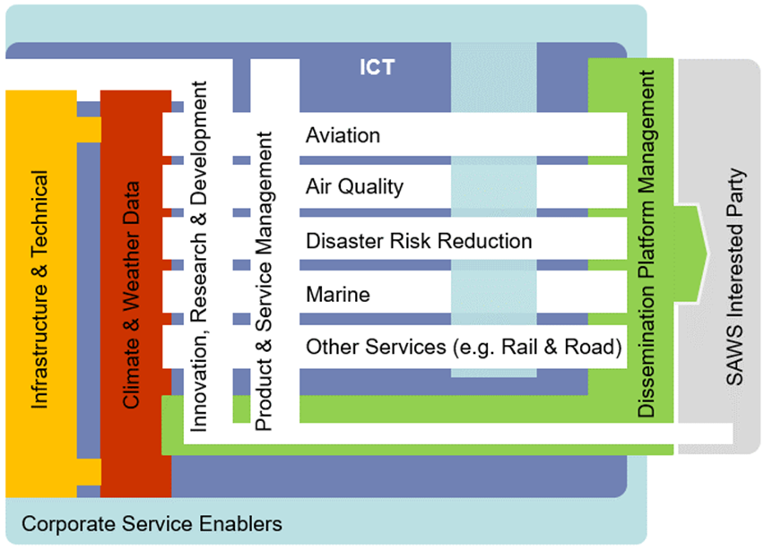
SAWS Strategy 2019/2020 – 2023/2024
Performance environment
Integrated Services Strategy (ISS)

Slide 33
The End

